Slide 1

Job Recruitment System
Group 7 presents an innovative solution for streamlining job recruitment processes. Our database system addresses key challenges in applicant tracking and management. It offers a centralized platform for efficient hiring workflows.
Vigneshwar Reddy G
Alex Ch
Bharath B
Kasi Vishwanath M
Sumanth K
Notes:
Good morning/afternoon everyone. [Pause]
I'm Vigneshwar Reddy G, and on behalf of Group 7, I'm excited to present our Job Recruitment Database System. With me today are my teammates Alex, Bharath, Kasi Vishwanath, and Sumanth.
Our project addresses a critical challenge in modern HR operations. Let me share why this matters. [nextslide]

Slide 2
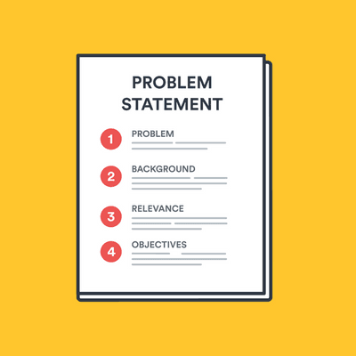
Problem Statement
1
Manual Tracking
2
Data Inefficiency
HR teams struggle with time-consuming paper-based application processes.
Scattered information leads to difficulties in candidate comparisons and decision-making.
3
Lack of Centralization
4
Inconsistent Updates
Absence of a unified system causes communication gaps between departments.
Applicants often left in the dark about their application status.
Notes:
Imagine you're an HR manager handling hundreds of applications. Currently, you face four major challenges:
First, manual tracking. HR teams are drowning in paperwork. Every application requires manual processing, eating up valuable time that could be spent on actual candidate evaluation.
Second, data inefficiency. Information is scattered across emails, spreadsheets, and paper files. This makes it nearly impossible to effectively compare candidates or make quick decisions.
Third, we have a serious lack of centralization. Different departments can't easily communicate about candidates. HR might be reviewing a resume while the hiring manager is trying to schedule an interview, with no way to coordinate effectively.
Finally, there's the problem of inconsistent updates. Applicants are often left wondering about their status, leading to poor candidate experience and potential loss of top talent.
These aren't just minor inconveniences – they're costing companies valuable time, resources, and potentially their best candidates.
Our solution transforms this entire process through a comprehensive database system that addresses each of these pain points head-on.
Now, I'll hand over to Alex, who will explain how our system solves these challenges.

Slide 3

System Purpose
Streamline recruitment process
Connect employers and job seekers
Efficient application management
Search/Filter Jobs
Functional Requirements
User Types
Admin job posting management
Administrators (Employers)
Applicant profile creation
Job Seekers (Applicants)
Application status tracking
Skills management
Search and filter capabilities
Notes:
"Thank you, Vigneshwar.
Our system's primary purpose is straightforward: to bring the entire recruitment process into one efficient, digital ecosystem.
Let me break down exactly what our system achieves:
First, we streamline the recruitment process. Everything from job posting to final hiring decisions happens in one platform.
Second, we create a direct connection between employers and job seekers. No more lost emails or missed communications.
Third, we enable efficient application management with real-time tracking and updates.
Now, let's look at the specific requirements we've implemented:
Now, let's look at the specific requirements we've implemented: [Switch to requirements slide]
For Administrators, who are typically employers or HR personnel, we've built:
A comprehensive job posting management system
Real-time application tracking tools
Analytics and reporting capabilities
For Job Seekers, we've created:
Easy profile creation and management
Skill documentation and matching
Real-time application status tracking
The key feature that sets our system apart is the skills management system. [Pause] This allows for precise matching between job requirements and candidate qualifications.
All of this is supported by powerful search and filter capabilities, ensuring that both employers and candidates can find exactly what they're looking for.
I'll now pass it over to Bharath, who will explain how we've designed our database to support these features."

Slide 4
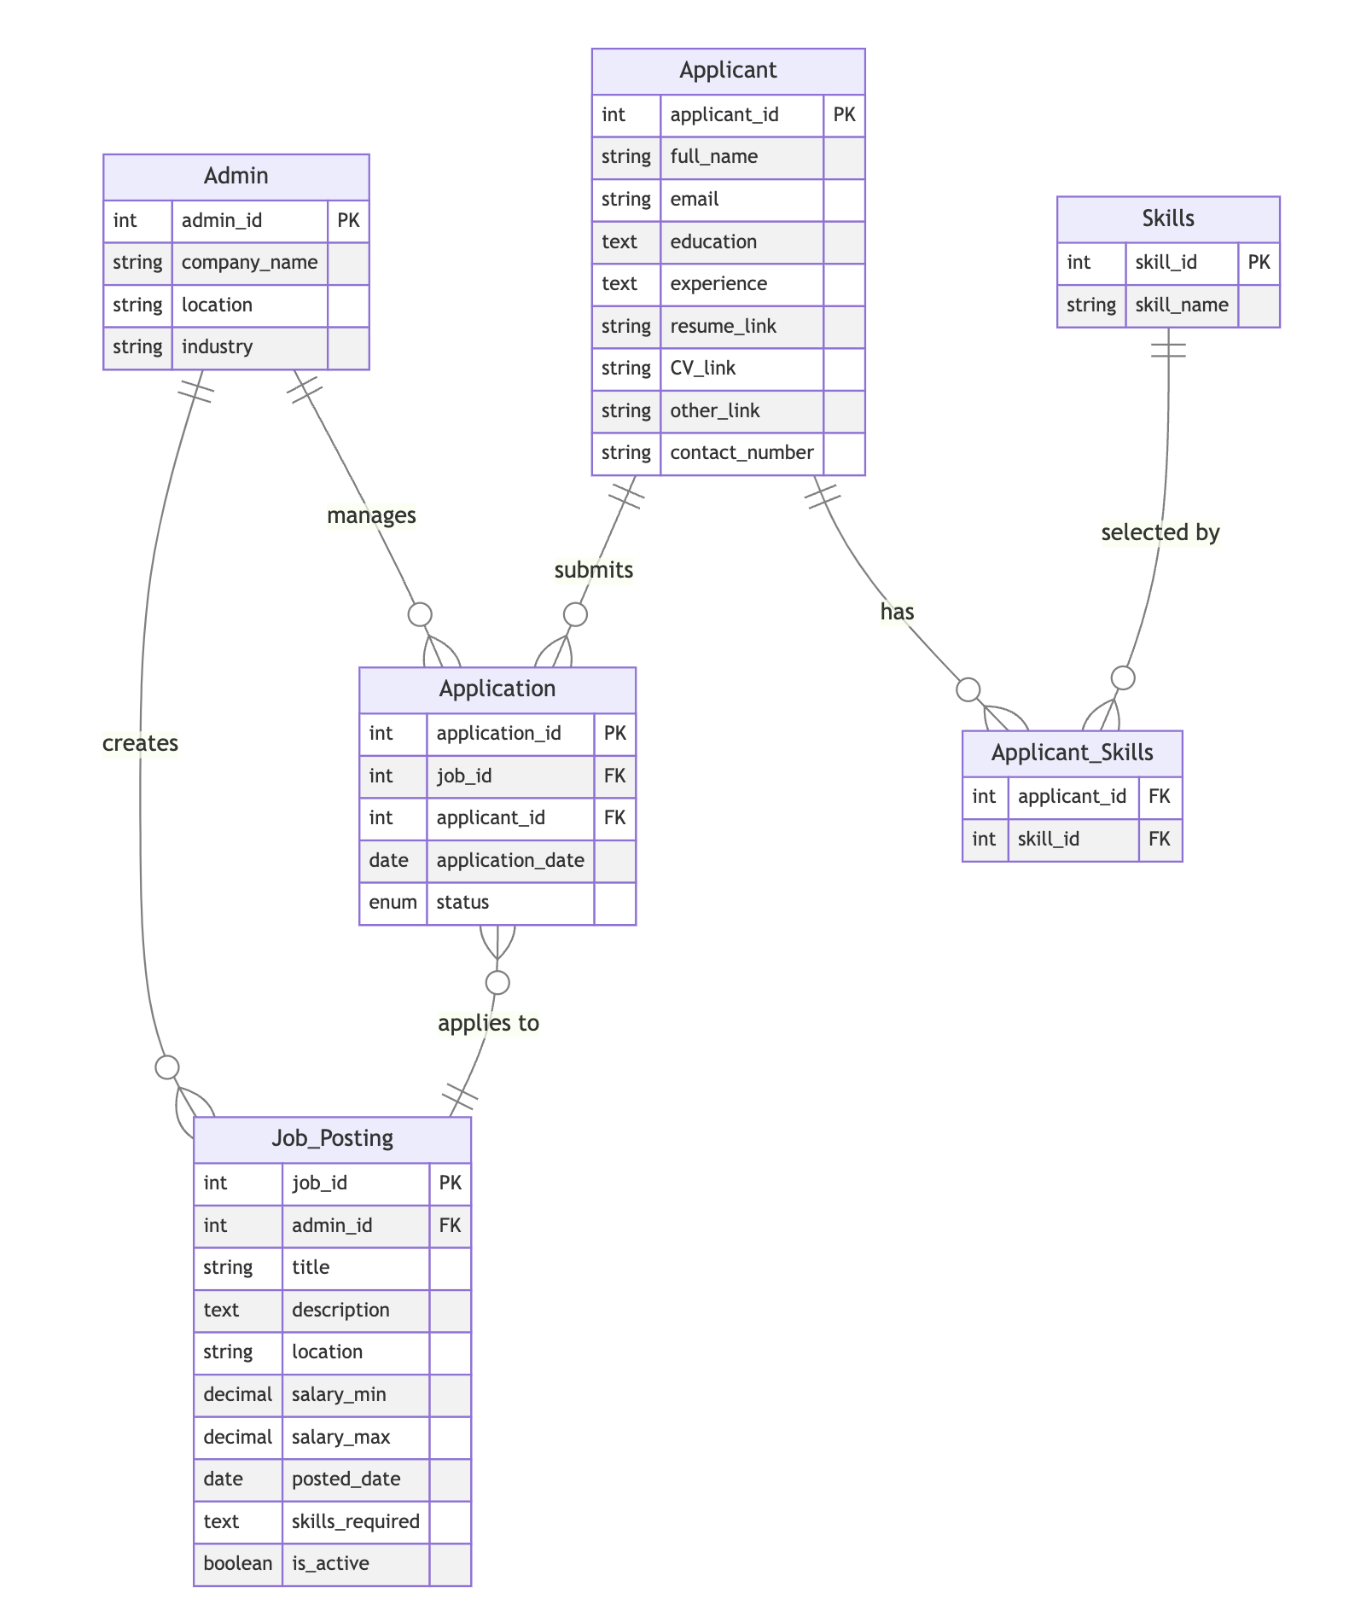
Database Design
Core Entities
Relationships
Admin, Applicant, Job_Posting, Application, Skills, Applicant_Skills.
Carefully designed connections ensure data integrity and efficient querying.
Normalization
Scalability
Tables are structured to minimize redundancy and optimize database performance.
Design allows for future expansion and addition of new features.
Notes:
"Thanks, Alex.
The foundation of our entire system is a robust and efficient database design.
Let me walk you through our core entities:
We have six main tables: [Point to each as you mention them]
Admin table for employer information
Job_Posting table for listing details
Applicant table for candidate profiles
Application table to track applications
Skills table for skill definitions
And Applicant_Skills for matching
Our relationships are carefully designed for maximum efficiency.

Slide 5

Database Schema
Table
Key Fields
Purpose
Admin
admin_id, company_name
Store employer information
Job_Posting
job_id, admin_id, title
Manage job listings
Applicant
applicant_id, full_name
Store job seeker profiles
Application
application_id, job_id, applicant_id
Track job applications
Skills
skill_id, skill_name
Stores Skills
Applicant_Skills
applicant_id, skill_id
Match Skills with Applicant
Notes:
Let's look at some key fields:
Admin table has admin_id and company_name
Job_Posting connects to Admin through admin_id
Applications link jobs and applicants together
Skills are tracked separately for flexible matching

Slide 6

Data Integrity Measures
1
Primary Keys
Unique identifiers ensure each record is distinctly addressable.
2
Foreign Keys
Maintain referential integrity between related tables.
3
Constraints
Enforce data validity through ENUM types and DEFAULT values.
4
Default Values
Automatically populate columns with a predefined value.
Notes:
We've implemented several critical data integrity measures:
Primary Keys ensure each record is unique
Foreign Keys maintain relationships between tables
Constraints prevent invalid data entry
Default Values automate standard fields

Slide 7

Database Optimizations
Indexing
Primary Keys
Foreign Keys
Search fields
Query Optimization
Joins Optimization
Prepared Statements
Efficient filtering
Notes:
For optimization, we've implemented:
Strategic indexing on frequently searched fields
Query optimization for complex joins
Prepared statements for security and performance
Now, Kasi will show you how these technical foundations enable our key features."

Slide 8





Key Features
Job Management
Employers can easily post, edit, and manage job listings.
Application Tracking
Real-time updates on application status for both employers and applicants.
Skills Matching
Automated comparison of job requirements with applicant skills.
Search & Filter
Advanced search capabilities for both jobs and candidates.
Notes:
"Thank you, Bharath. [Pause]
Let me demonstrate how our technical implementation translates into practical features.
First, our Job Management system: [Show interface]
The Application Tracking system provides: [Navigate through system]
Our Skills Matching system is particularly powerful: [Demonstrate matching]
The Search and Filter functionality allows users to:

Slide 9
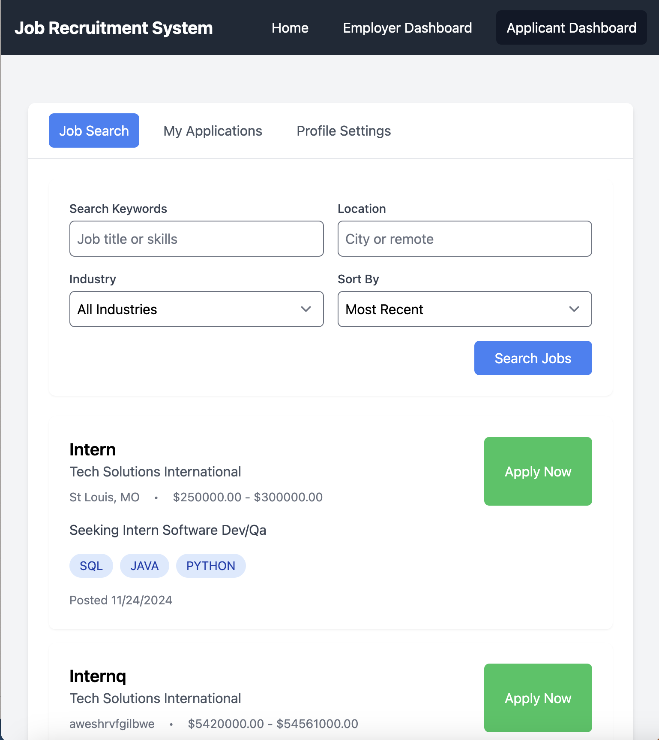
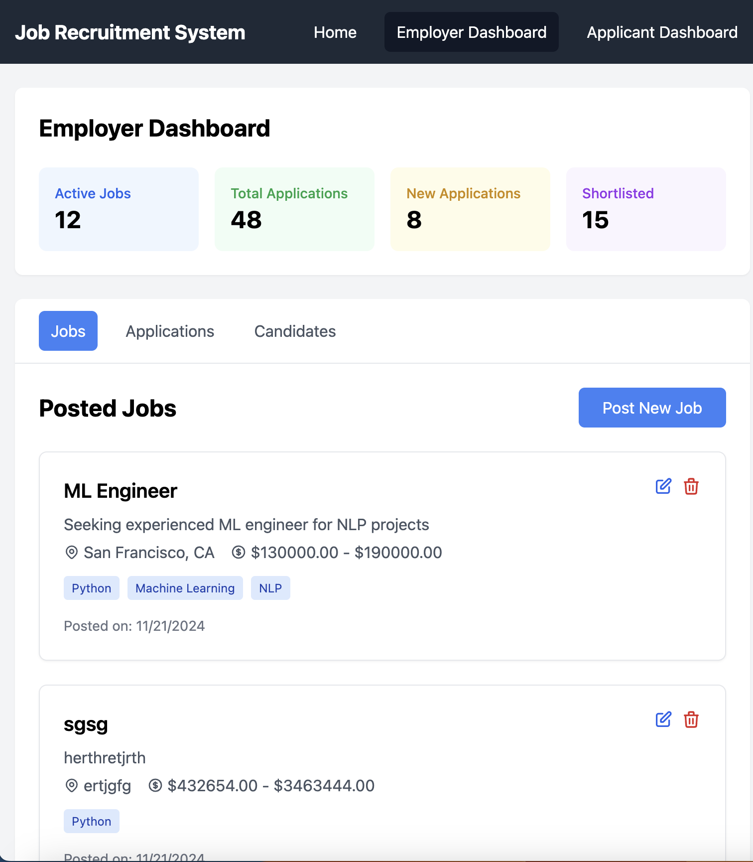
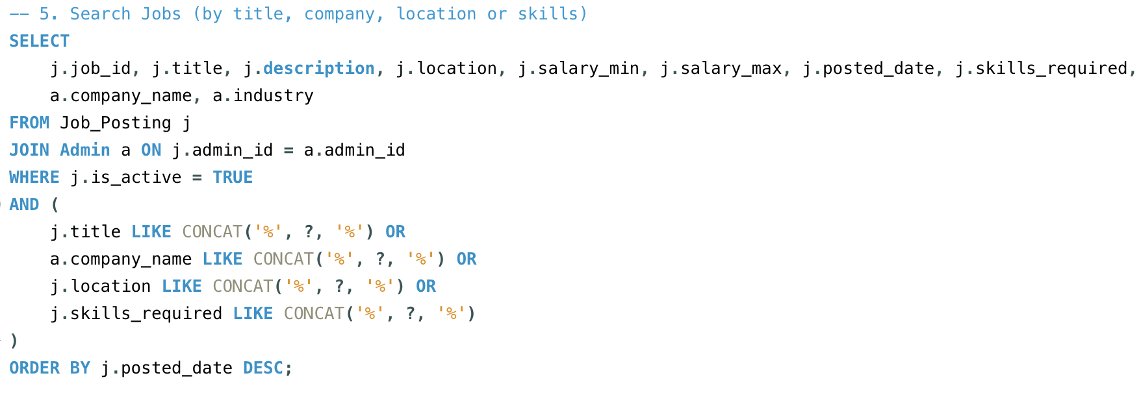
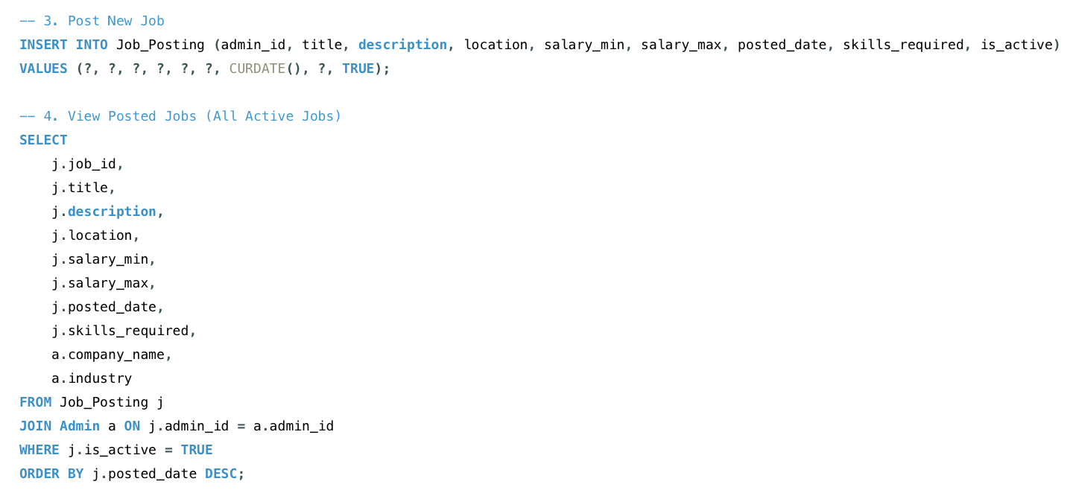
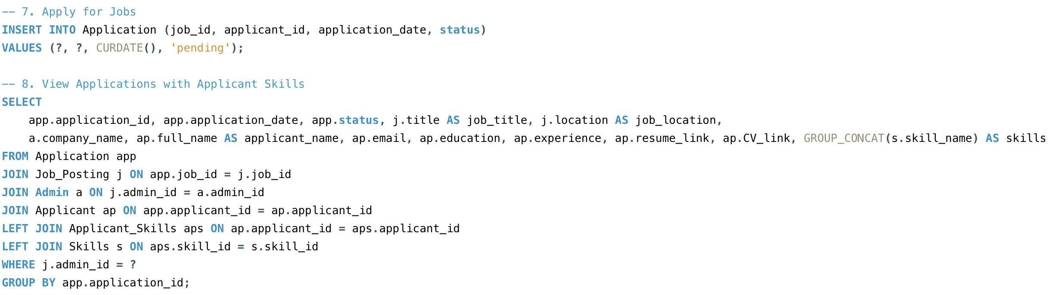
Employer Dashboard
Comprehensive overview of active jobs, application statistics, and candidate management tools.
Applicant Profile
User-friendly interface for job seekers to manage their profile and track applications.
Notes:
Job Management system: Employers can post new positions in seconds
Edit existing listings instantly
Track all applications in real-time
Application Tracking system provides:
Real-time status updates
Automated notifications
Complete application history

Slide 10
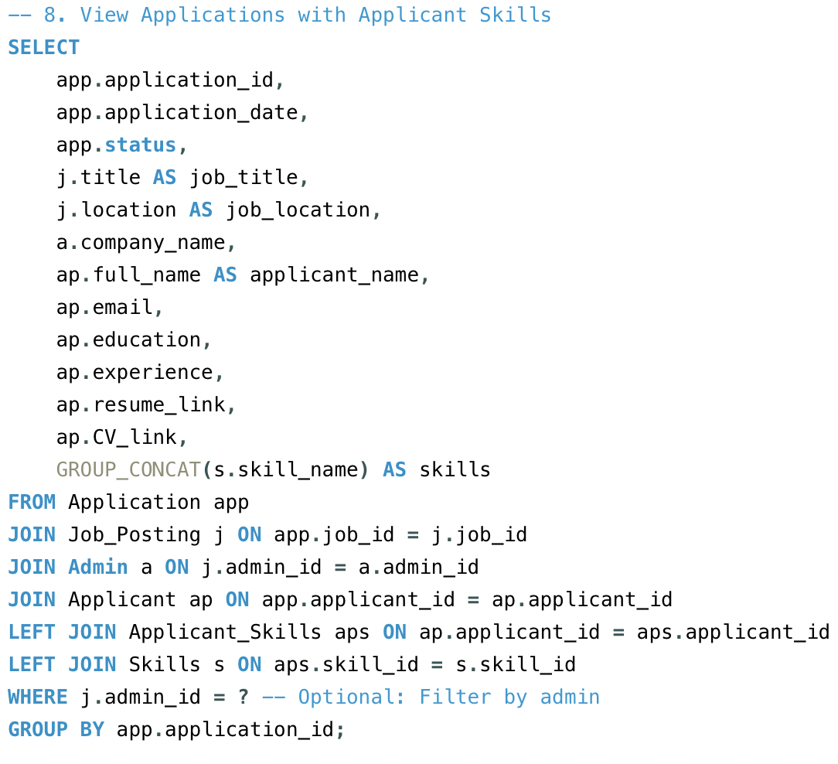
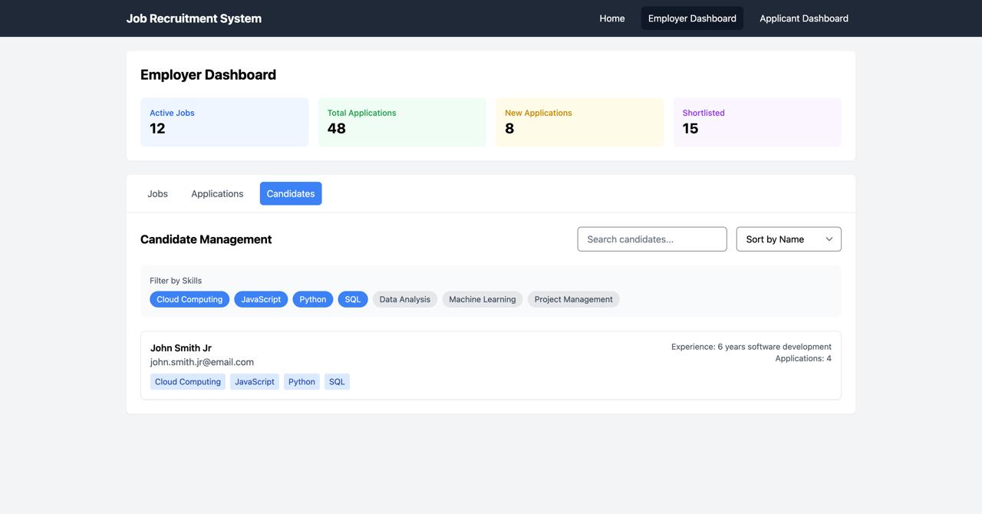
Skills System
Flexible skill tagging
Easy skill matching
Efficient searching
Skills
skill_id (PK)
skill_name
Applicant_Skills
applicant_id (FK)
skill_id (FK)
PRIMARY KEY (applicant_id, skill_id)
Notes:
Our Skills Matching system is particularly powerful:
Automatic skill comparison
Percentage match calculations
Suggested candidate rankings

Slide 11
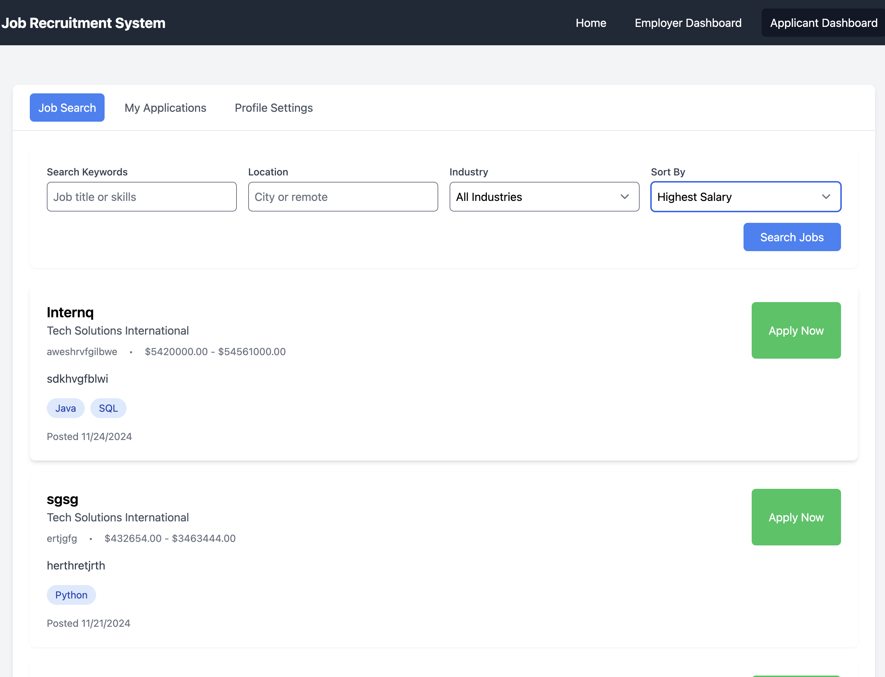
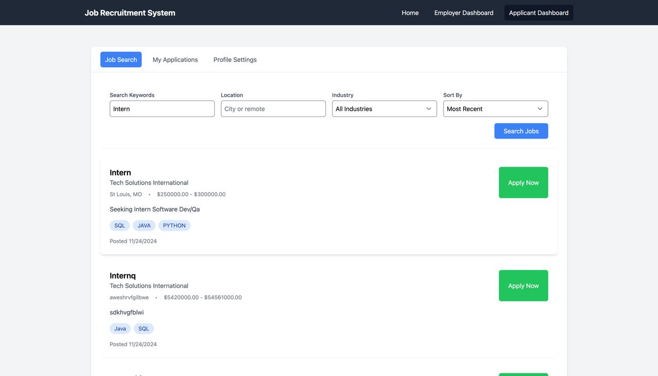
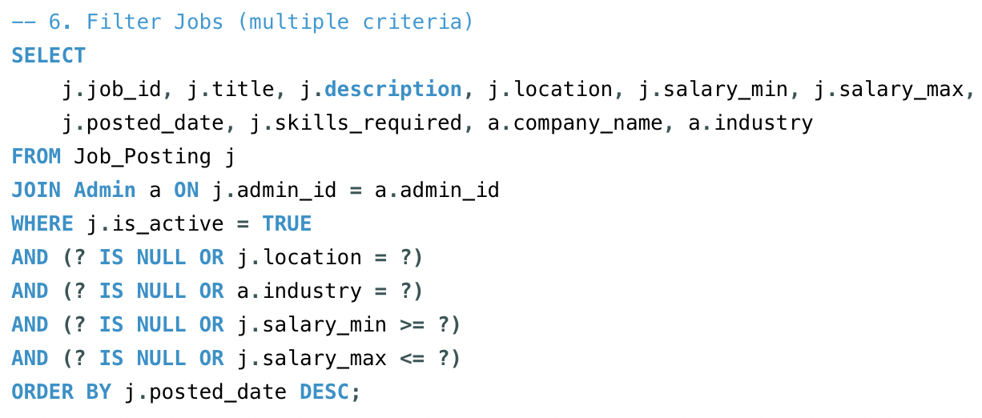
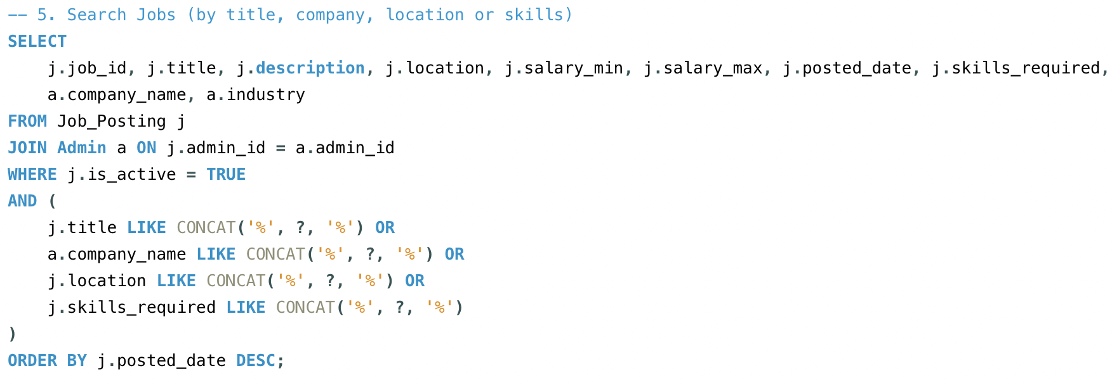
Search/Filter
Search
Search Jobs, Applications based on different values/attributes like Role, Skills, etc.
Filter
Filter Jobs, Applications, Candidates using different criteria like Industries, Salary, Status of Applications, Skills etc.
Notes:
The Search and Filter functionality allows users to:
Filter by multiple criteria
Sort by relevance
Save common searches

Slide 12



Technical Implementation
Frontend
Backend
React components ensure a responsive and dynamic user experience.
Robust MySQL database with RESTful API for efficient data management.
Notes:
On the technical side, we've built this using:
React for the frontend, ensuring a responsive experience
MySQL for robust data management
RESTful APIs for efficient communication

Slide 13
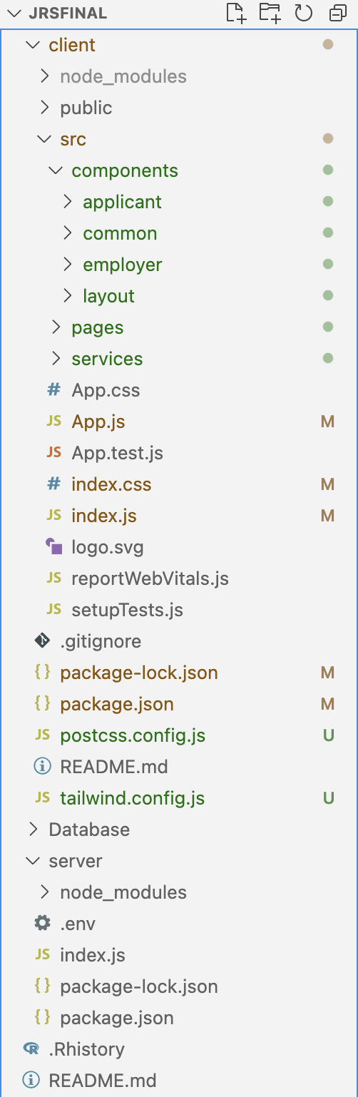
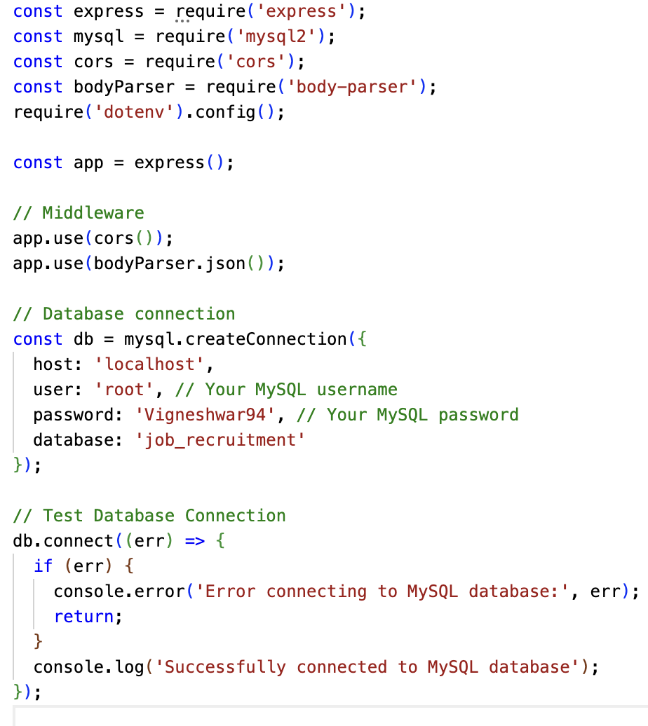
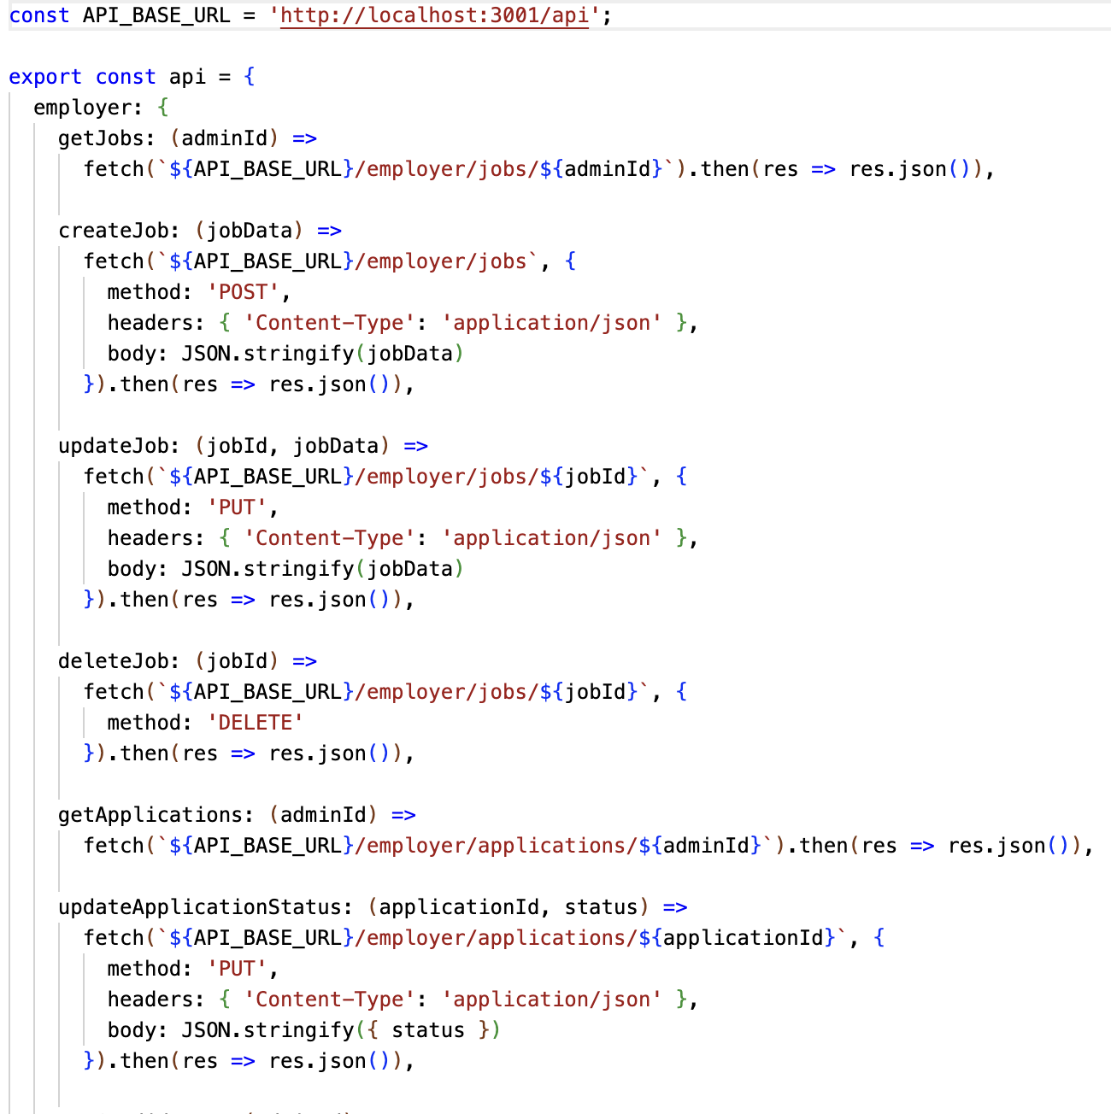
Technical Implementation
Structure
Database Connection
APIs
Notes:
Let me quickly demonstrate our homepage...
A [Brief demo] will be given by vigneshwar

Slide 14
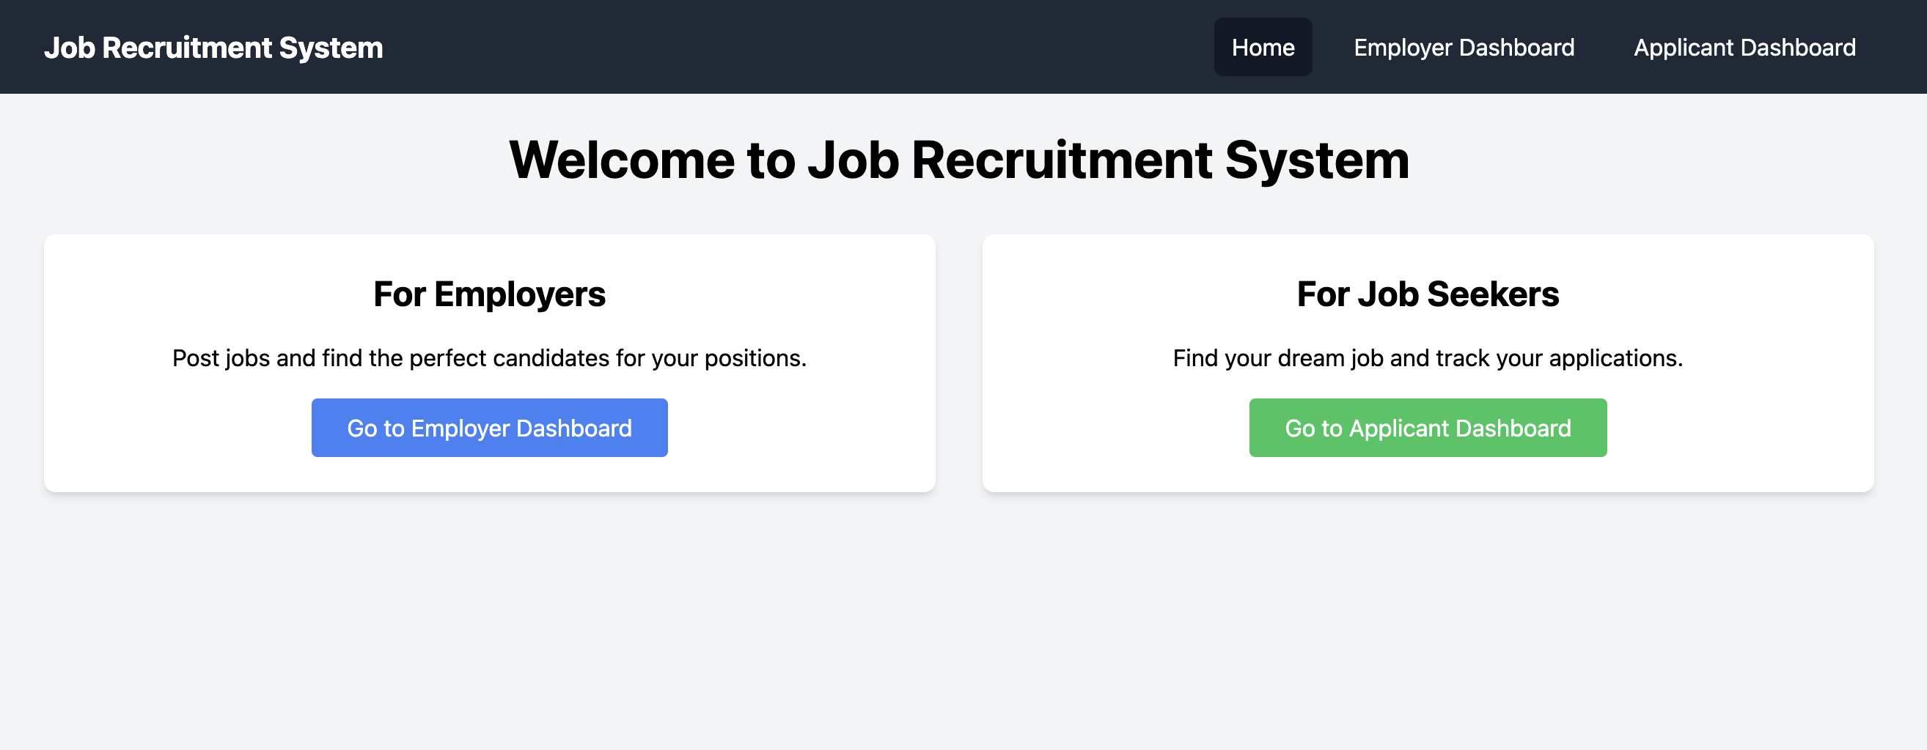
WebApplication
Homepage
Clear user role separation with intuitive navigation and modern design.
Notes:
This is our homepage with separate dashboards for Employer and applicant

Slide 15
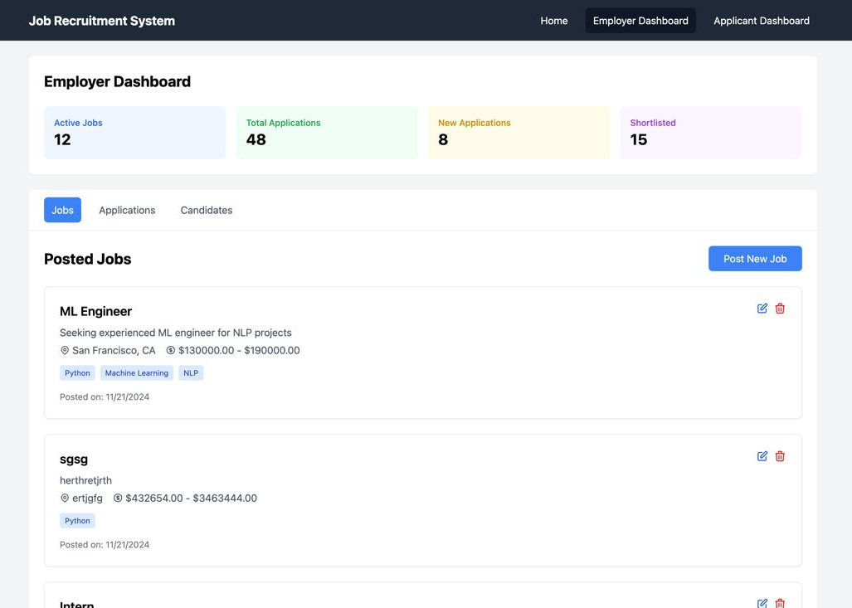
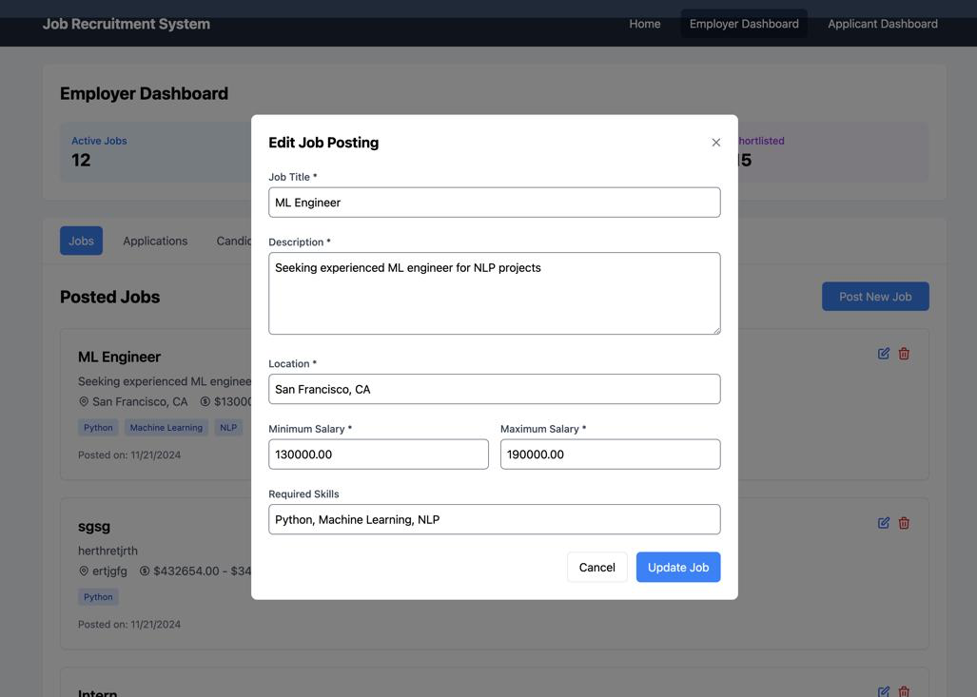
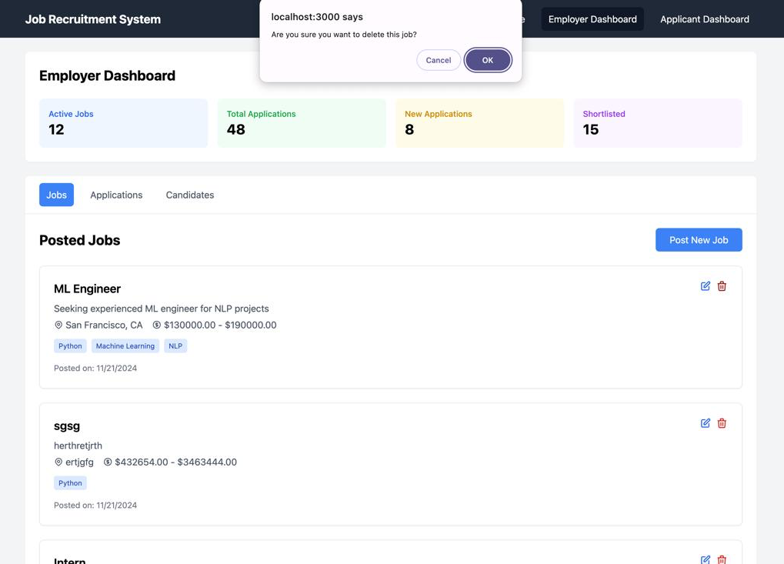
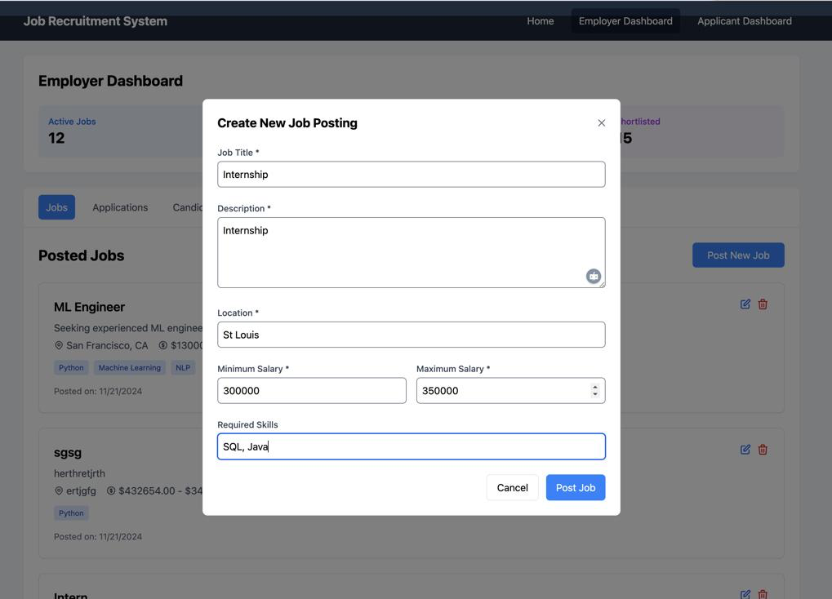
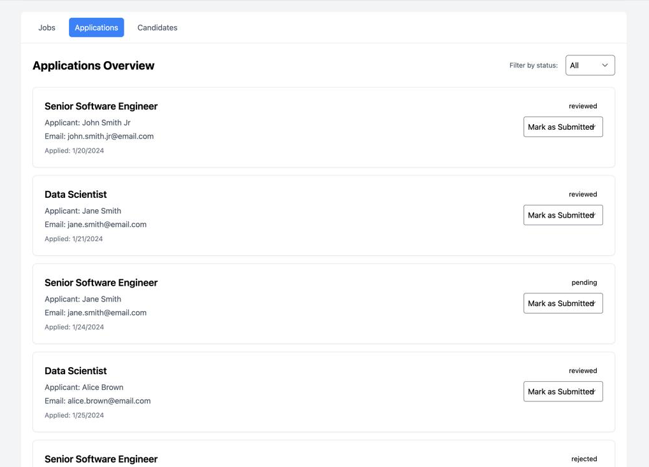
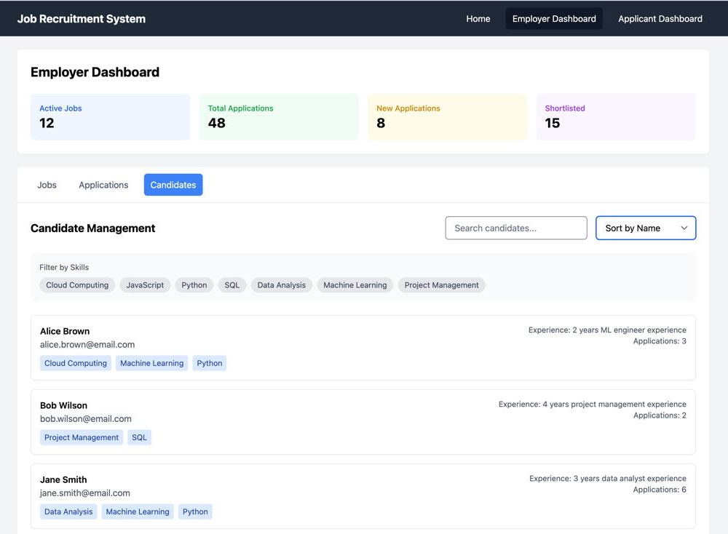
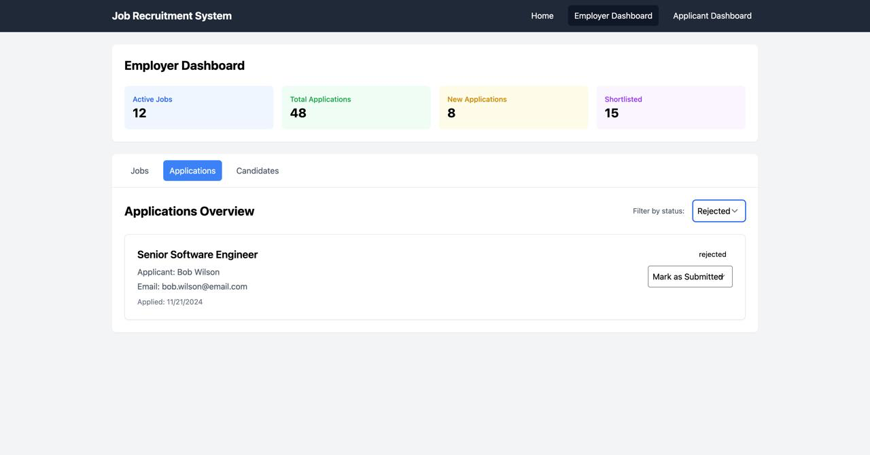
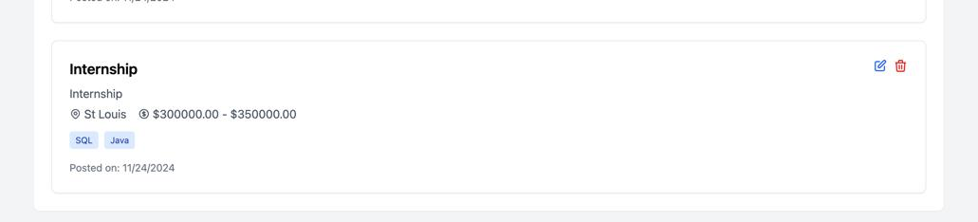
Demonstration
Notes:
Let me quickly demonstrate our application...
Sumanth will now discuss where we're taking this system in

Slide 16

Future Enhancements
1
Full-text search
2
Caching layer
Implement predictive modeling for hiring success rates and market trends.
Utilize machine learning algorithms to improve job-candidate matching accuracy.
3
Data Archive
4
Integration
Develop native mobile apps for on-the-go access and push notifications.
Connect with popular job boards and professional networking platforms.
Notes:
While our current system is fully functional, we have exciting plans for future enhancements.
We're planning to implement:
Full-text search with predictive modeling
A caching layer for improved performance
Automated data archiving
Integration with major job boards

Slide 17
Normalized design importance
Query optimization impact
Security implementation
Scalability considerations
INSIGHTS &
LEARNINGS
Notes:
Our key learnings from this project include:
The critical importance of normalized database design
How query optimization significantly impacts performance
The necessity of robust security measures
How to build for scalability from day one

Slide 18
THANK YOU!
Questions?
Notes:
Before we open for questions, I'd like to thank:

